Slide 1
Meeting of Screening Committee for
Krishi Karman Award 2015-16
DEPARTMENT OF AGRICULTURE
HARYANA

Slide 2
HARYANA AT A GLANCE
Geographical Area (GA) 44.21 lakh ha (1.4% of India)
Cultivable Area (CA) 36.70 lakh ha (83 % of GA)
Cultivated Area 36.16 lakh ha (98.52% of CA)
_____________________________________________________
Gross Cropped Area 64.71 lakh ha
Cropping Intensity 185.04 %
_____________________________________________________
Irrigated Area 29.31 lakh ha (81 %)
Canal Irrigation 12.10 lakh ha (41.3%)
Groundwater Irrigation 17.21 lakh ha (58.7%)
Under-ground Water 54 % brackish
_____________________________________________________
Farming Families 16.17 lakh (2010-11 Census)
Marginal Farmers 7.78 lakh (48.1%)
Small Farmers 3.15 lakh (19.5%)
Medium Farmers 2.84 lakh (17.6%)
Others 2.40 lakh (14.8%)
Share of Agri. in SGDP 10.20 %
___________________________________________________
Notes:
2
2

Slide 3
Major Achievements
Krishi Karman Award - 3 times (2010-11, 2011-12 & 2014-15s)
Highest productivity of 5182 kg/ hect in Wheat (2011-12)
Commendation Award 2012-13.
56% area under Basmati group.
2nd largest contributor of food grains (14.12%) to Central pool.
163.33 Lakhs MT of food grains production during 2015-16.

Slide 4
FOOD-GRAINS PRODUCTION 2015-16
in ‘000’ tonnes
 | Sr. No. | Crop | Production
Kharif | 1 | Rice | 4145
 | 2 | Jowar | 28
 | 3 | Maize | 17
 | 4 | Bajra | 652
 | 5 | Kharif Pulses | 10
 |  | Sub-Total | 4852
Rabi | 1 | Wheat | 11352
 | 2 | Gram | 26
 | 3 | Barley | 99
 | 4 | Rabi Pulses | 4
 | 5 | Summer Moong | 44
 |  | Sub-Total | 11525
Oilseeds | 1 | Kharif Oilseeds | 5
 | 2 | Rabi Oilseeds | 824
 | 3 | Sunflower | 38
 |  | Sub-Total | 867
 |  | Total | 16377

Slide 5
Strategy and Measures for
Food-Grains and Oilseeds production
Low productivity blocks identified.
Special attention to Wheat and Rice.
Yellow rust resistant varieties encouraged in Wheat.
Special meetings with DWR, CCS HAU Scientists and DAC
Special campaigns launched to control yellow rust.
Special Advisories through organizing farmer training camps/schools, gosthies, melas, campaigns in schools, print media, newspaper and electronic media etc.
100 % treatment of certified seed of Wheat.
SRR improved for important crops e.g. Wheat (53.00%), Barley (97.00%), Paddy (32.00%), Bajra (72.00%), Oilseeds (100%).
Inter-cropping in sugarcane with wheat, mustard, vegetables etc.
Promotion of agro-forestry.
Promotion of water saving devices -UGPL and Sprinkler irrigation systems.
Promotion of mechanization viz., lazer land leveler, happy seeder, zero seed drill, straw reaper etc.

Slide 6
INITIATIVES
Promotion of DSR to save irrigation water.
Promotion of Basmati group of paddy.
Area under maize increased.
Focus on line sowing of wheat.
Promotion of Relay cropping (Wheat in Cotton).
Promotion of green manuring.
Promotion of Summer Moong.
Special focus on villages deficient in nutrients based on soil fertility maps.
Kisan Melas at each district HQ.
Farmers Training Camps and exposure visits at each block.
Farmers Field Schools (FFSs).
Krishi Samvad magazine being circulated free of cost to all the villages.

Slide 7
NFSM-Component wise utilization 2015-16
(Rs. in Lakhs)
S.No. | Component | Funds Released | Funds Spent | % Utilization
A) NFSM
1 | Wheat | 1381.70 | 844.12 | 61.093
2 | Pulses | 1071.20 | 679.65 | 63.448
3 | Coarse Cereals | 409.01 | 306.07 | 10.436
4 | Commercial Crops | 45.60 | 9.33 | 74.832
5 | Additional Area under pulses | 380.03 | 65.45 | 17.222
 | Total | 3333.34 | 1904.62 | 45.41
B)
1 | CDP (RKVY) | 8538.86 | 5511.48 | 64.54
2 | NMOOP | 1494.45 | 590. 83 | 39.5

Slide 8
EFFORTS FOR ENSURING EFFECTIVE COORDINATION WITH RELATED DEPARTMENTS
State Level Coordination Committee meetings held under the Chairmanship of the Chief Minister.
State Level Committee under the Chairmanship of ACS Agriculture for fertilizer arrangements.
State Level Sanctioning Committee of RKVY under the Chairmanship of the Chief Secretary.
State Level Executive Committee on Food Security Mission under the Chairmanship of the Chief Secretary.
State Seed Production Committee under the Chairmanship of ACS Agriculture.
Inter Departmental Working Group under the Chairmanship of ACS Agriculture.

Slide 9
POST HARVEST MANAGEMENT & MARKETING SUPPORT
  14 Nos of Pack House-cum-Cold Storages have been set up.
  Value addition / Post harvest management facilities i.e. grading, sorting, packaging, cool chambers and ripening facilities provided in Pack Houses.
  Kisan Call Centre at Panchkula for proper dissemination of market price information.
  Agro Malls- a unique project of its kind in India.
  Four Agro Malls at Rohtak, Karnal, Panipat and Panchkula constructed.
  106 principal yards, 178 sub-yards and 192 purchase centres in State.
Notes:
9

Slide 10
POST HARVEST MANAGEMENT & MARKETING SUPPORT
  India International Horticulture Market at Ganaur being developed with an estimated cost of Rs. 1350 crores, in an area of 537.6 Acres land.
  Market will have Processing Centres, Import/ Export House, Electronic/Remote Auction System, Grading/ Packaging Mechanized lines, Cold Storages/ Controlled Atmosphere Chambers, Ripening Chambers, Parking and Transport Areas, Shops for Wholesalers, Organic Food Section, Farmer’s Retail Market, Business Park, Agri. Business Information Centre, Commodity Exchange Centre, National Agricultural Trade Centre (NATC) and Logistic Hub.
Notes:
10

Slide 11
FUTURE STRATEGIES
Targets of food grains (2016-17)
Area in 000 hects.
Av. Yield in kgs/hect.
Production in 000 tonnes.
S. No | Crops | 2015-16
 |  | Area | Av. Yield | Prod.
A) | KHARIF
1. | Rice | 1250 | 3400 | 4250
2. | Jowar | 65 | 570 | 37
3. | Maize | 50 | 2800 | 140
4. | Bajra | 460 | 1859 | 855
5. | Kh. Pulses | 60 | 950 | 37
 | Sub-Total | 1885 | 2832 | 5339
B) | RABI
6. | Wheat | 2550 | 4705 | 11997
7. | Gram | 80 | 1312 | 105
8. | Barley | 42 | 3580 | 150
9. | Rabi pulses | 10 | 1200 | 12
10 | Summer Moong | 64 | 780 | 50
 | Sub-Total | 2682 | 4572 | 12264
 | Total (A+B) | 4567 | 3830 | 17603

Slide 12
TARGETS OF OILSEEDS 2016-17
Area in 000 hects.
Av. Yield in kgs/hect.
Production in 000 tonnes.
S. No | C) Oilseeds
 |  | Area | Av. Yield | Prod.
Kharif
1. | Kh. Oilseeds | 10 | 950 | 10
 | Sub Total | 10 | 950 | 10
Rabi
4. | Mustard | 600 | 1850 | 1110
5. | Sunflower | 15 | 1700 | 26
 | Sub Total | 615 | 1847 | 1136
 | Total | 625 | 1834 | 1146
 | Grand Total (A+B+C) | 5192 | --- | 18749

Slide 13
Future Strategy and Road Map for achieving higher production
Growth rate of 4 % targeted.
Reclamation of Water Logged & Saline Area.
Timely Sowing of Crops.
Promotion of water saving technologies (UGPL/ Sprinkler/Drip).
Promotion of High-yielding & Yellow Rust-resistant wheat varieties.
Plan to bring more area under hybrid rice and short duration varieties.
Plan to cover more area under summer moong cultivation.
Promotion of organic farming/micro nutrients /organic fertilizer / bio fertilizers.
Promotion of inter-cropping and relay farming.
Promotion of DSR in Rice.
Promotion of alternate crops of paddy such as maize and cotton.
Soil Health Management through green manuring and monitoring of crop residue burning.

Slide 14
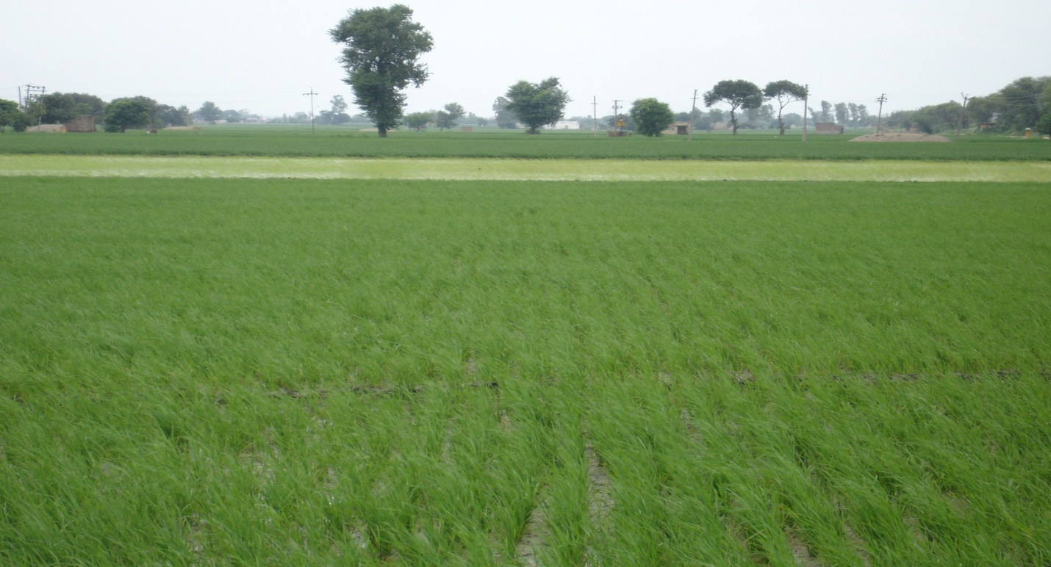
Initiatives to improve Rice Production
Direct Seeding of Rice (DSR)
Saving of 20 – 25 % irrigation water
Saving of labour & energy
Advancement in crop sowing

Slide 15
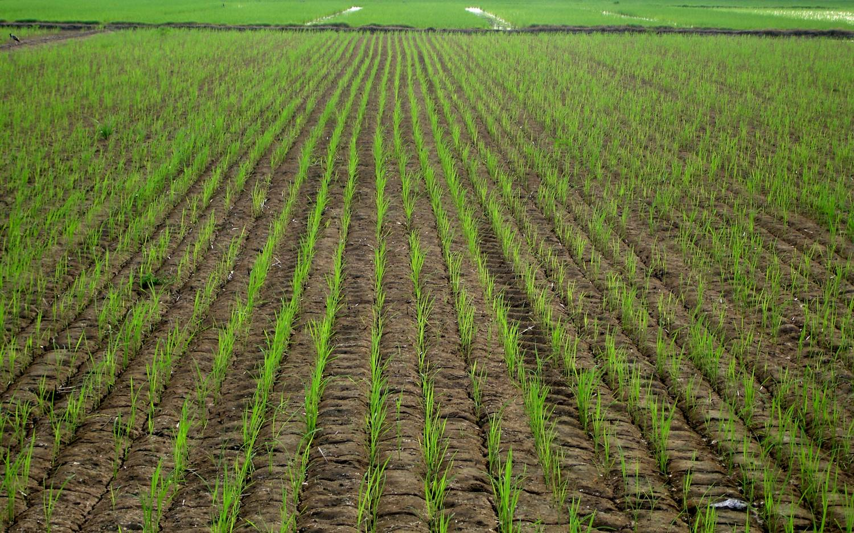
Agro-techniques for DSR

Slide 16
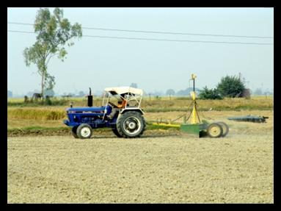


Farm Mechanization
Lazer Leveller
Straw Reaper
Rotavator

Slide 17
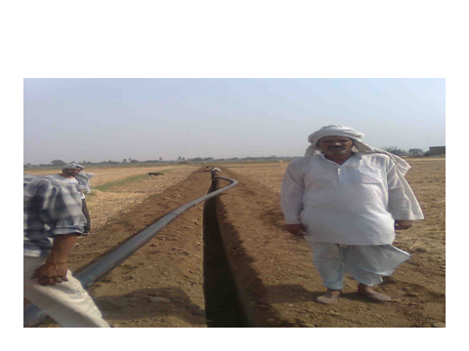
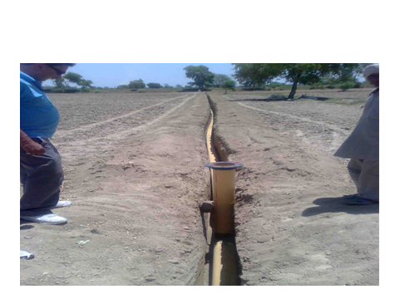
UGPL

Slide 18

Thank You
website: agriharyana.nic.in
e-mail : agriharyana2009@gmail.com
agriculture@hry.nic.in

