Slide 1
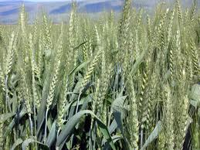
Meeting of Screening Committee for
Krishi Karman Award 2012-13 on
14.12.2013
DEPARTMENT OF AGRICULTURE,
HARYANA

Slide 2
HARYANA AT A GLANCE
The State of Haryana came into existence on 1st November, 1966.
Geographical Area (GA) 4.42 m ha (1.4% of India)
Cultivable Area (CA) 3.757 m ha (85.0% of GA)
Cultivated Area 3.64 m ha (96.9% of CA)
_____________________________________________________
Gross Cropped Area 6.351 m ha
Cropping Intensity 185%
_____________________________________________________
Irrigated Area 3.069 m ha (84 %)
Canal Irrigation 1.283 m Ha (42.8%)
Groundwater Irrigation 1.784 m Ha (57.2%)
Under-ground Water 54 % brackish
_____________________________________________________
Farming Families 16.17 lac (2011 Census)
Marginal Farmers 7.78 lac (48.1%) (own 3.61 lac ha – 9.9%)
Small Farmers 3.15 lac (19.5%) (own 4.63 lac ha – 12.8%)
Others 5.24 lac (32.4%) (own 28.21 lac ha – 77.3%)
___________________________________________________
2
Notes:
2

Slide 3
  Mile Stones
  Twice recipient of Krishi Karman Award for
  best performing State under Wheat during the years 2010-11 and 2011-12.
  Second largest contributor of food grains to the central pool.
  1st in Basmati Rice export.
  Other Achievements
  Productivity of both Coarse and Basmati Paddy during Kharif 2012 was 4,003 kg per hect. and 2,587 kg per hect. respectively. This is the highest ever in the State since its creation in 1966.
  Productivity of Kharif food grains during Kharif 2012 at 2819 kg. per hectare was the highest in the State since its inception.
  Haryana achieved record production of 39.76 lac MTs of Rice during Kharif-2012. It was the highest production ever achieved in the State.
  Area under Summer Moong is 73,000 ha. and production reached 46000 tonnes during Zaid Rabi 2012-13.
  which is the highest ever in the State.

Slide 4
Trends of Food grains Production
Year | Area (000 hect.) | Production (000 tonnes) | % increase/ decrease
2005-06 | 4311 | 13006 | -
2006-07 | 4348 | 14763 | 13.50
2007-08 | 4478 | 15294 | 3.60
2008-09 | 4622 | 16178 | 5.78
2009-10 | 4541 | 15346 | -5.14
2010-11 | 4702 | 16568 | 7.96
2011-12 | 4630 | 18342 | 10.70
2012-13 | 4386* | 16225 | -11.54
*Drop in the area under food grains production in 2012-13 is on account of corresponding increase in the area under Guar cultivation.

Slide 5
ACHIEVEMENT OF FOODGRAINS PRODUCTION 2012-13
Area in 000 hects.
Av. Yield in kgs/hect.
Production in 000 tonnes.
S. No | Crops | 2011-12 |  |  | 2012-13
 |  | Area | Av. Yield | Prod. | Area | Av. Yield | Prod.
 | KHARIF
1. | Rice | 1235 | 3044 | 3759 | 1215 | 3272 | 3976
2. | Jowar | 65 | 500 | 33 | 56 | 500 | 28
3. | Maize | 9 | 2666 | 24 | 9 | 2556 | 23
4. | Bajra | 577 | 2040 | 1177 | 411 | 1925 | 785
5. | Kh. Pulses | 39 | 750 | 29 | 25 | 1000 | 25
 | Total | 1925 | 2609 | 5022 | 1716 | 2819 | 4837
 | RABI
6. | Wheat | 2522 | 5182 | 13069 | 2497 | 4452 | 11117
7. | Gram | 79 | 911 | 72 | 47 | 1128 | 53
8. | Barley | 42 | 3633 | 153 | 48 | 3479 | 167
9. | Rabi pulses | 6 | 1000 | 6 | 5 | 1000 | 5
10. | Summer Moong | 56 | 350 | 20 | 73 | 625 | 46
 | Total | 2705 | 4924 | 13320 | 2670 | 4265 | 11388
 | Grand Total | 4630 | 3962 | 18342 | 4386 | 3699 | 16225

Slide 6
MAJOR FOCUS AREAS
Timely Sowing of Wheat promoted – 80% sowing by 30th November.
Seed Replacement Rate increased to 55% in Rabi 2012-13 from 54% in Rabi 2011-12 and 34% in Rabi 2010-11.
14.00 lac. qtl. Certified seed of Wheat distributed.
Emphasis laid on promotion of newly released (region specific) varieties.
  PBW-550, HD-2894, DPW 621-50 & HD-2967 promoted particularly in North-eastern part.
  HD-2851, PBW-590 & WH-1021 promoted under late sown conditions.
Seed Treatment
100% Treatment of Certified Seed of Wheat.
Other Steps
Resource Conserving Technology through promotion of Mechanization and Micro Irrigation System and Soil Health Management is being promoted .
Monitoring & Management of Yellow Rust disease.
Promotion of relay sowing of Wheat in Cotton.
Promotion of IPM, INM & IWM.
DSR being promoted
Summer Moong being promoted.

Slide 7
UTILIZATION OF FUNDS
2012-13
NFSM
(Rs. in Lakh)
* Including interest accrued during 2012-13
Particular | Wheat | Pulses | A3P | Total
Allocation | 2319.14 | 737.24 | 964.00 | 4020.38
Unspent balance | 96.24 | 42.34 | 98.71 | 237.29
Funds released | 2228.74 | 696.18 | 624.29 | 3549.21
Total funds available | 2324.98 | 738.52 | 723.00 | 3786.50
Funds utilized | 2257.51 | 713.61 | 666.33 | 3637.45
Unspent balance* | 122.61 | 31.80 | 56.67 | 211.08
% Utilization | 97.09 | 96.62 | 92.16 | 95.29

Slide 8
RKVY
Rs. in lac
Year | Allocation | Actual released by GOI | Utilization | Submission of UCs | % Utilization of Funds
2007-08 & 2008-09 | 6103.00 | 6102.03 | 6102.03 | 6102.03 | 100
2009-10 | 11277.00 | 11277.00 | 11277.00 | 11277.00 | 100
2010-11 | 22680.00 | 22562.91 | 22562.91 | 22562.91 | 100
2011-12 | 17687.20 | 17687.20 | 16749.69 | 16749.69 | 94.70
2012-13 | 20949.00 | 17988.00 | 16298.00 | 16298.00 | 90.60

Slide 9
SUB-SCHEMES OF RKVY
2012-13
(Rs. In Lakh)
Particular | Allocation | Expenditure | % utilization
AFDP | 1500.00 | 1188.57 | 79.24
VEGETABLE CLUSTER | 1200.00 | 1200 | 100
PROTIEN SUPPLIMENTS | 830.00 | 730.00 | 87.95

Slide 10
COORDINATION AND EFFORTS WITH RELATED DEPARTMENTS
State Level Coordination Committee under the chairmanship of Chief Minister State Level Committee under the chairmanship of PS Agriculture for fertilizer arrangements.
State Level Sanctioning Committee under the chairmanship of Chief Secretary.
State Level Executive Committee on Food Security Mission under the chairmanship of Chief Secretary.
State Seed Production Committee under the Chairmanship of Principal Secretary Agriculture.
Inter Departmental Working Group under the Chairmanship of PS Agriculture.
Agriculture Officers Workshop with SAU before Kharif and Rabi season to finalize package of practices.
There was no shortage of seed, fertilizer, power, irrigation and credit facilities during 2012-13.
The online updating of data on NFSM website will be updated shortly whereas the reports and information of NFSM have been put on the departmental website i.e. www.agriharyana.nic.in

Slide 11
FUTURE STRATEGIES
Targets of food grains (2013-14)
Area in 000 hects.
Av. Yield in kgs/hect.
Production in 000 tonnes.
S. No | Crops | 2013-14
 |  | Area | Av. Yield | Prod.
 | KHARIF
1. | Rice | 1150 | 3350 | 3852
2. | Jowar | 80 | 525 | 42
3. | Maize | 50 | 2800 | 140
4. | Bajra | 610 | 1950 | 1190
5. | Kh. Pulses | 60 | 1050 | 63
 | Total | 1950 | 2711 | 5287
 | RABI
6. | Wheat | 2500 | 4952 | 12381
7. | Gram | 62 | 1145 | 71
8. | Barley | 50 | 3900 | 195
9. | Rabi pulses | 10 | 1100 | 11
10. | Summer Moong | 93 | 753 | 70
 | Total | 2715 | 4688 | 12728
 | Sub Total | 4419 | 3956 | 17761

Slide 12
Contd…
100% Treatment of Certified Seed of Wheat.
Reclamation of Water Logged & Saline Areas.
2 lakh hectares to be brought under Under Ground Pipe Line (UGPL) in next 5 years (25 crore).
2 lakh hectares to be brought under Micro-Irrigation during next 5 years (50 crore).
High-yielding & Yellow Rust-resistant varieties of Wheat to be promoted.
More area under hybrid rice planned to be covered.
Area under Summer Moong will be increased to 93,000 hectares.
Farm Mechanization to be promoted in a big way.
Green Manuring to be promoted to improve the soil health.
DSR in Rice will be promoted further.

Slide 13
FUTURE PROSPECTS
Wheat
  The productivity of Wheat has reached its potential level & scope for further improvement is limited. However, department has taken some initiatives to further improve Wheat productivity.
    Planting of Wheat at 18 cm spacing instead of 20 cm will be promoted vigorously. This system of planting may improve Wheat productivity by 5-10 %.
    Varietal replacement will be another focus area to improve productivity. Efforts will be made to bring more area under HD-2967, HD-2894, DPW-621-50, WH-1105 & HD-2851.
    New varieties like DBW-71, WH-1124, HD-3059 & HD-3043 will be introduced in the production programme for the next year.
    Relay sowing of wheat in cotton for improving Wheat productivity in Cotton belt.
    Low productivity blocks/districts are being given special attention.

Slide 14
Contd...
Rice
    Direct Seeding have excellent potential & 50% Basmati area is targeted to be brought under this system by the end of 12th plan.
    New Basmati variety PUSA-1509 will be promoted.
    Cultivation of hybrid rice will be promoted to improve rice productivity (20 % area).
    Targeted 55,000 hectares area to be shifted to Maize during Kharif 2014.
Summer Moong
    Good prospects of Summer Moong in Paddy areas as adequate irrigation facilities are available.
    Plan to bring 1.00 lac hectares area under this crop.
Spring Maize
    Good scope of spring Maize in areas vacated by potato crop.
    Productivity of 50-60 quintals per hectare can be achieved.
    An area of 20,000 hectares targeted during spring 2013-14.

Slide 15
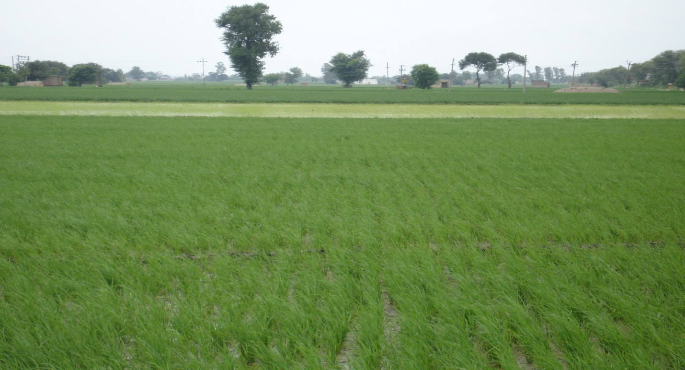
Initiatives to improve Rice Production
Direct Seeding of Rice (DSR)
Saving of 20 – 25 % irrigation water
Saving of labour & energy
Advancement in crop sowing

Slide 16
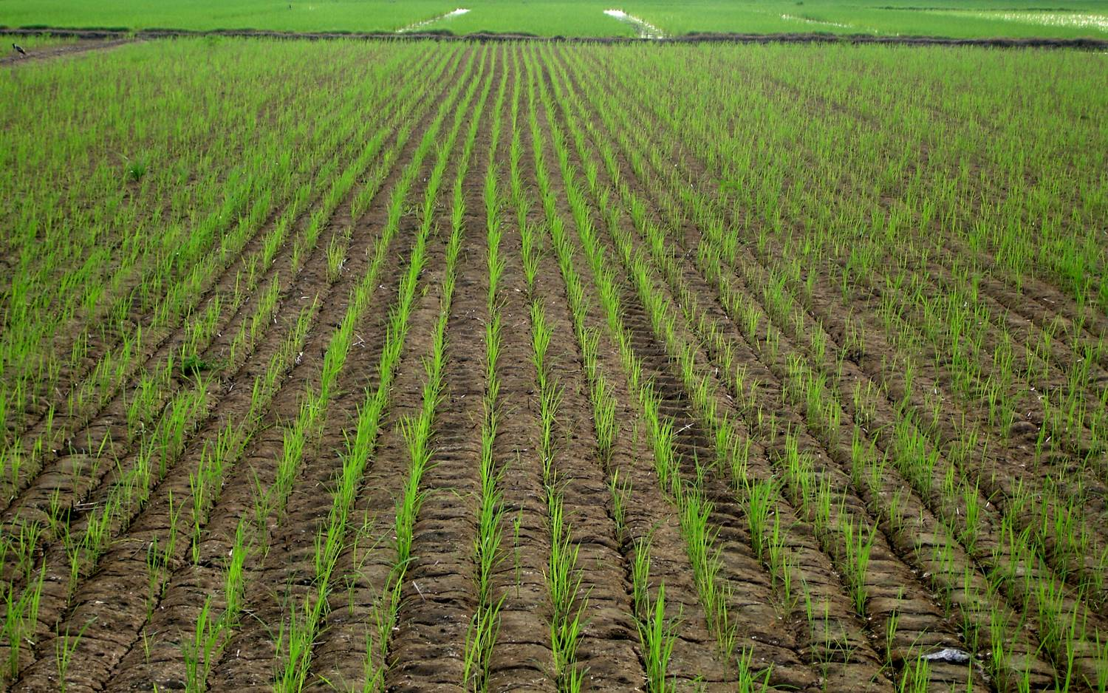
Agro-techniques for DSR

Slide 17
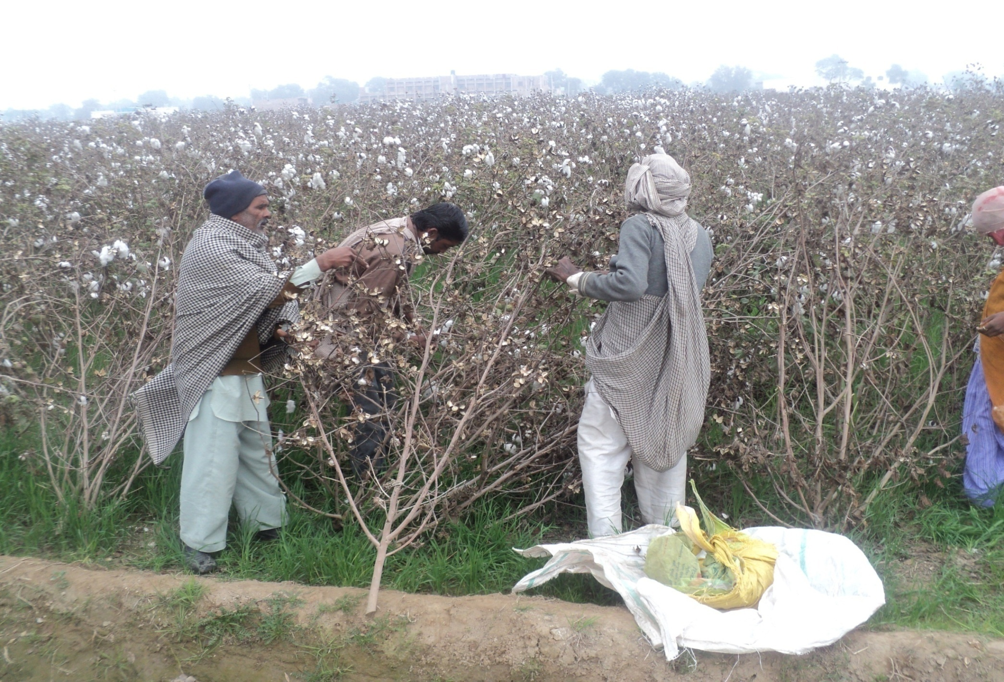
Relay Sowing Wheat in Cotton
17

Slide 18
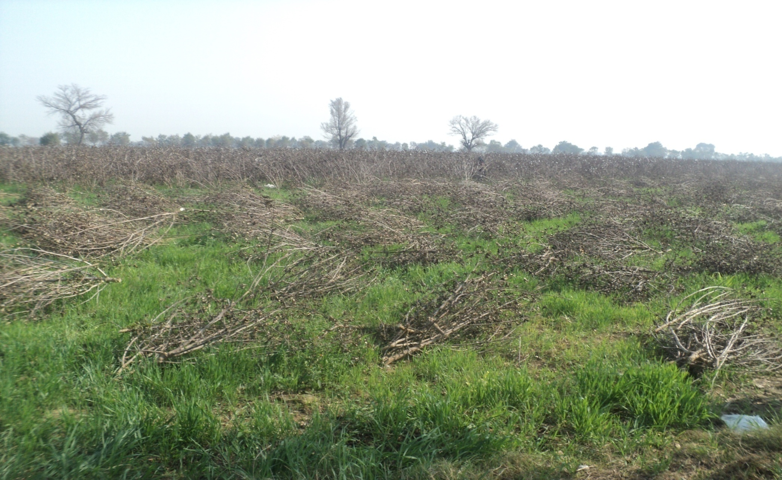
18

Slide 19
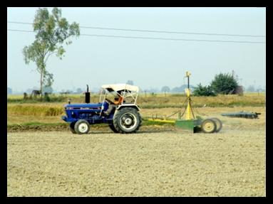
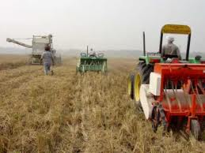
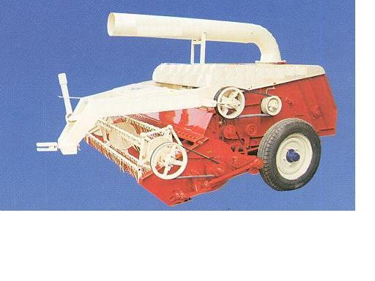
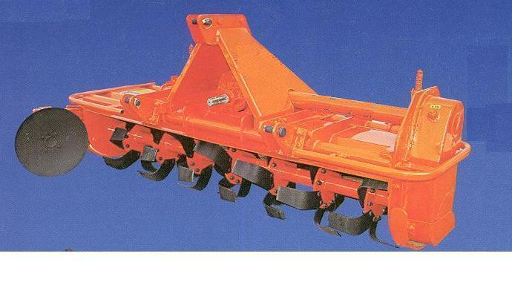
PROMOTION OF FARM IMPLEMENTS
500 Laser Land Levelers targeted to be
distributed on subsidy in 2013-14.
Subsidy @Rs.50,000/- per machine.
Happy Seeder - sowing of Wheat crop after harvesting of Paddy crop in standing stubbles.
Cost around Rs 100000/-
Rotavators help in better decomposition of crop residue & saves fuel and labour..
Subsidy @ 50% of the cost or Rs.30,000/-
per machine.
5,00 Straw Reapers will be distributed
on subsidy.
Subsidy @Rs.40,000/- per machine.

Slide 20
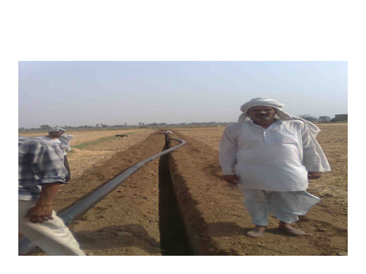
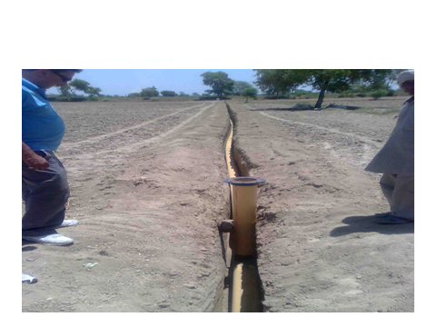
BEST PRACTICES
Under Ground Pipe Line
ISI Marked HDPE/PVC Pipes are laid at one meter depth.
Subsidy @ 50% or maximum Rs. 60,000 per beneficiary.

Slide 21
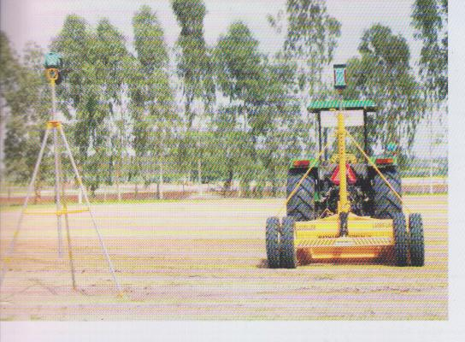

LASER LAND LEVELER
(Introduced in 2007-08)
Water Saving 15-20%.
Leads to uniform irrigation.
Reduces consumption of fertilizer and pesticides 18-20%.
Saving in Electricity and Diesel.
Desired slope can be maintained to drain out the excess water in heavy rainfall areas.
Increase in irrigated area/command area.

Slide 22
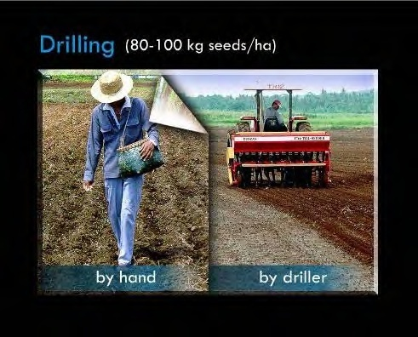
PROMOTION OF DSR
Water Saving in DSR (CIMMYT Report)
Basmati Varieties | 21 to 31 %
Non-Basmati | 22 %
Hybrids | 20 to 25 %

Slide 23
Thank You
website: agriharyana.nic.in
e-mail : agriharyana2009@gmail.com
agriculture@hry.nic.in

